Slide 1
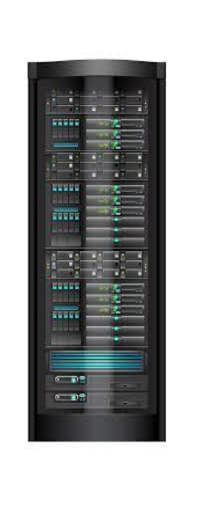

Traditional Page Lifecycle
Initial Request
HTML
Get-request
Page Reload
HTML

Slide 2
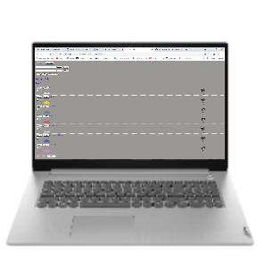
SPA Lifecycle
Initial Request
HTML
AJAX
{JSON}

